Slide 1
Big Data 101
Introduction to Hadoop & Machine Learning

Slide 2

Hello!
I am Craig Covey
Data Analyst @ Concho
You can find me on LinkedIn @ www.linkedin.com/in/craigcovey7

Slide 3
Data Science
Hadoop
Big Data
SQL
Regression
Velocity
Statistics
Unstructured Data
Scala
Variety
Storage
Algorithms
Cloudera
Database
Python
NoSQL
Streaming Data
Volume
Data Mining
Machine Learning
R
Prediction
Data Analysis
Search
HDFS
Model
Distributed Computing

Slide 4
Big Data is a Problem!
Not a solution

Slide 5
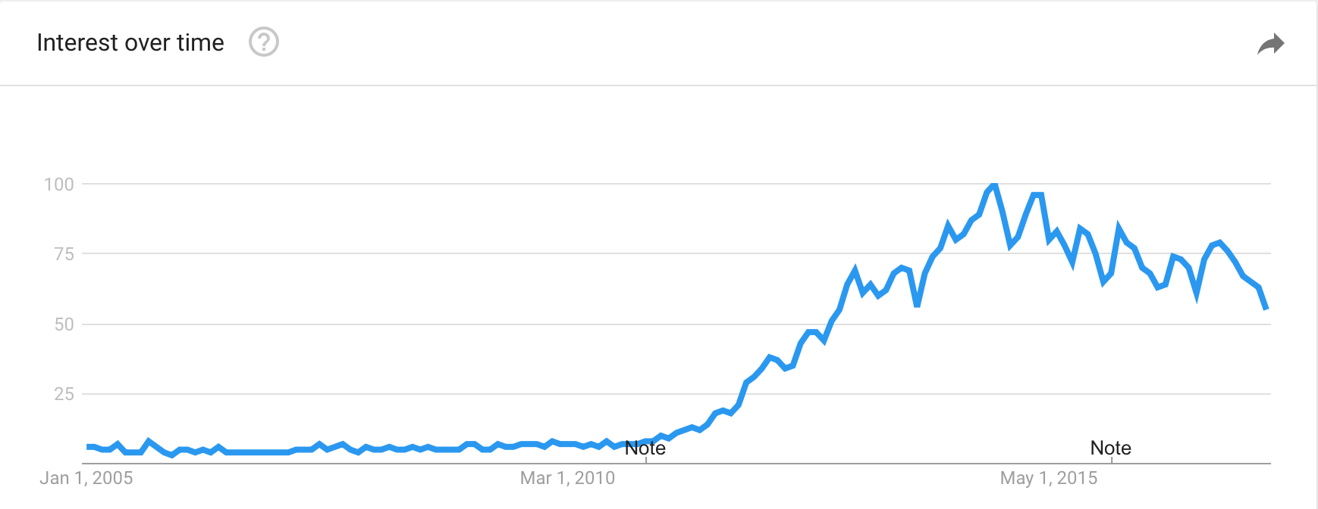
2005
The year the term Big Data was created
Source: floq.to/lG1Cf
Google Trends Search graph of “big data” in the USA

Slide 6
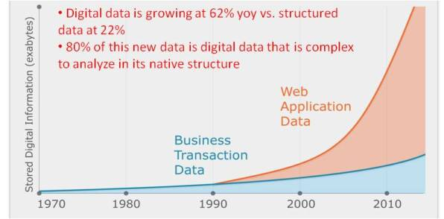
But why 2005?
Answer: the internet and smartphones dramatically increased data generation
Source: https://practicalanalytics.co/2011/11/06/explaining-hadoop-to-management-whats-the-big-data-deal/

Slide 7
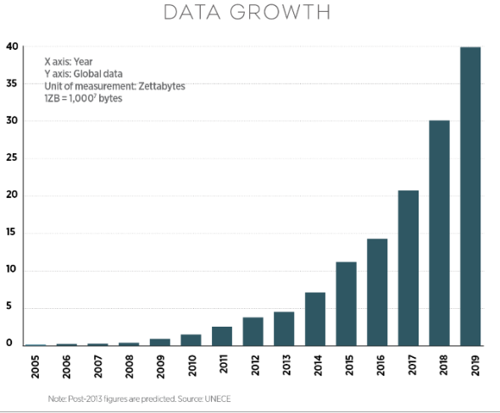
Exponential Data Growth
Chart is from the United Nations Economic Commission for Europe (UNECE)
Source: http://www.nojitter.com/post/240170228/the-network-impact-of-big-data

Slide 8
Big Data
Is a large set of data that is almost impossible to manage and process using traditional business intelligence tools

Slide 9
The Three V’s of Big Data
Volume
Velocity
Variety

Slide 10
Data Velocity
Big Data: expanding on 3 fronts
Real Time
Near Real Time
Periodic
Batch
MB
GB
TB
PB
Data Volume
Table
PDF
Database
Social
Images
Docs
Video
Data Variety
IoT

Slide 11
If Big Data is a problem, the most popular solution is …
1
A technology called Hadoop

Slide 12
What is Hadoop?
Hadoop is an open source framework for distributed processing of large data sets across clusters of many commodity computers

Slide 13
What is Hadoop?
Open Source
Distributed File System
Distributed Computing
Scales with Data
¢
On Non-Expensive Servers

Slide 14
Hadoop Distributed File System (HDFS)
Small bits of data can be processed more quickly than large whole files
Data is broken into small pieces and and spread throughout the cluster
A “Cluster” is a collection of servers (nodes) linked together

Slide 15

Distributed processing moves the processing & computing software to the data, rather than move the data to the software
Distributed Processing and Computing
Each node in the cluster has a storage layer and a processing layer
Node 1
Node 2
…
Node n
Processing Layer
Storage Layer

Slide 16





Top Big Data Vendors
Source: https://www.linkedin.com/pulse/big-data-who-best-hadoop-vendors-2017-bernard-marr

Slide 17

OK, now that you have a lot of data,
what do you do with it?
OK, now what?
Analyze it!
With machine learning!

Slide 18
What is Machine Learning?
2
Finding patterns in data

Slide 19
Machine Learning is …
Machine Learning works with data and processes it to discover patterns that can be later used to analyse new data.
~ Dr. Natalia Konstantinova
Source: http://nkonst.com/machine-learning-explained-simple-words/

Slide 20
Machine Learning Algorithm Categories
Supervised
Unsupervised

Slide 21
Machine Learning Algorithm Categories
Supervised
Unsupervised
Majority of learning
Know the true answer
Teacher supervising the learning process
Goal is to approximate a function well enough to accurately predict new data
Popular examples: regression & random forest
Used less often
No correct answer
No teacher
Goal is to model the underlying structure or distribution in the data to learn more about the data
Popular examples: K-Means clustering, Gaussian Mixture Model

Slide 22


Machine Learning != Big Data
And Machine Learning != Hadoop
Machine Learning
!=
Big Data

Slide 23
But …
More Data
Makes
Machine Learning
Perform
Better

Slide 24
Machine Learning Examples
Medical diagnosis
Netflix “% match”
Amazon product recommendation
Siri, Google Assistant, Alexa
iPhone/Android keyboard next word prediction
Using satellite images to detect farmer crop fraud
Analyze Twitter tweets for sentiment analysis

Slide 25
Machine Learning Examples In Oil and Gas
Predict oil and gas production based upon well and frac parameters
Analyze streaming drilling rig data
Cluster wells based upon geological and frac characteristics
Scan log files and pick geological formation tops
Use case-based reasoning to match problems observed in data
Analyze streaming frac data
Predict reserves

Slide 26
Thanks!
Any questions?
You can find me on:
LinkedIn @ www.linkedin.com/in/craigcovey7

Slide 27
Appendix

Slide 28
Spark
HBase
Impala
Solr
Hadoop
Sqoop
Oozie
Flume
NiFi
HDFS
Kafka
Hive

Slide 29
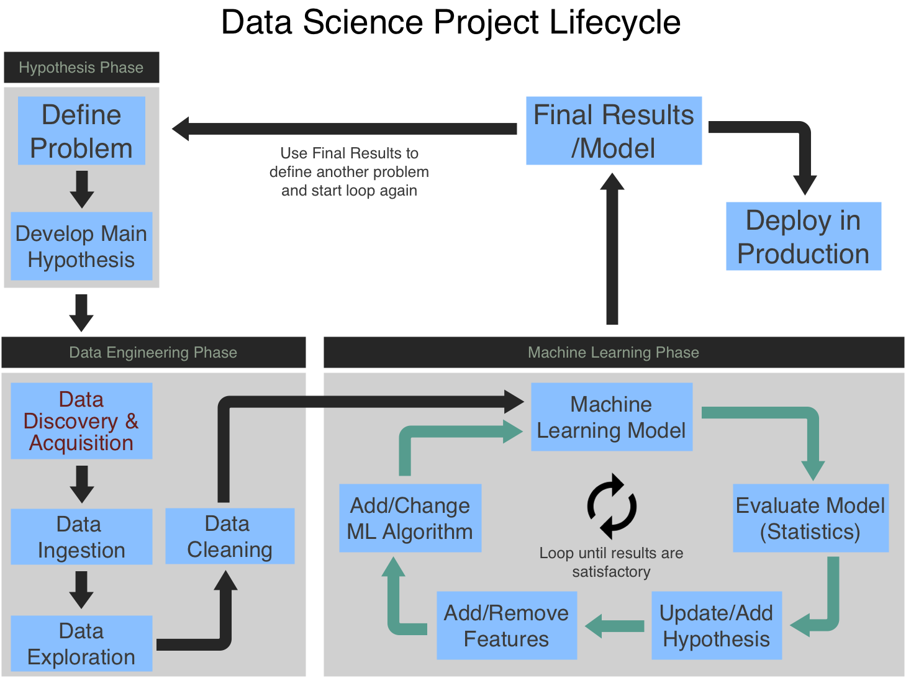

Slide 30
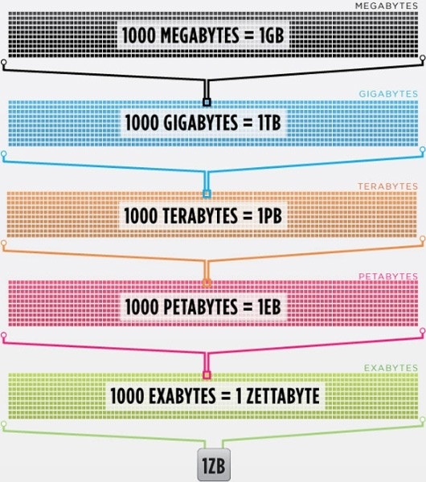
Source: https://www.engadget.com/2011/06/29/visualized-a-zettabyte/

